Slide 1



2026 Point In Time Count
Training provided by Winged Wolf Innovations

Slide 2
What we will cover today
2026 Point-in-Time (PIT) Count • County Lead Training
Training objectives
By the end of this session, County Leads will be able to…
Explain the purpose of the PIT Count and why accuracy matters in rural communities
Plan countywide coverage using maps and “tracks” (zones) to prevent gaps and duplication
Recruit and support Local Team Leads and volunteer teams
Set up communications, safety expectations, and day-of operations
Help teams access the Count App and complete a practice/test run
Rural Nevada Continuum of Care (RNCoC)
Notes:
Frame this as practical training. Emphasize: you don’t need to do every task personally—you are building a plan, a team, and a clear structure so volunteers can succeed.

Slide 3
Why an accurate PIT Count matters
2026 Point-in-Time (PIT) Count • County Lead Training
Resources & funding
Planning & strategy
Visibility & credibility
PIT data is part of the information HUD uses for national reporting and local planning
Undercounting can make rural needs look smaller than they are
Identifies where people are staying (and where outreach is needed)
Helps target services (youth, families, veterans, chronic homelessness)
A consistent, well-run count builds trust with partners and communities
Clear documentation helps explain rural conditions and constraints
Bottom line: a “good count” is organized, consistent, safe, and well-documented.
Rural Nevada Continuum of Care (RNCoC)
Notes:
Emphasize that rural homelessness can be “hidden” (vehicles, dispersed locations, doubled-up situations that don’t show up as unsheltered). Accuracy comes from good planning: tracks, trained volunteers, and solid documentation. [Sources] - https://www.hudexchange.info/programs/hdx/pit-hic/ - https://www.huduser.gov/portal/datasets/ahar.html

Slide 4
PIT Count basics (HUD context)
2026 Point-in-Time (PIT) Count • County Lead Training
What is the PIT Count?
Key terms (quick reference)
A count of people experiencing homelessness on a single night in January
Includes people who are sheltered (ES/TH/Safe Haven) and unsheltered
Locally planned and carried out by the Continuum of Care and partners
Sheltered: staying in an emergency shelter, transitional housing, or Safe Haven
Unsheltered: staying in a place not meant for human habitation (e.g., outside, vehicle, abandoned building)
De-duplication: steps taken to avoid counting the same person more than once
Rural Nevada Continuum of Care (RNCoC)
Notes:
Ground everyone in the basics. The PIT Count is one night, but the planning behind it is months of work. In rural areas, we rely heavily on local knowledge to find unsheltered locations and avoid gaps. Remind leads: definitions matter—consistent classification is what makes data comparable and usable. [Sources] - https://www.hudexchange.info/programs/hdx/pit-hic/

Slide 5
County Lead responsibilities (Before / During / After)
2026 Point-in-Time (PIT) Count • County Lead Training
BEFORE
DURING
AFTER
Build/validate maps & locations
Divide county into tracks (zones)
Collaborate with local agencies, law enforcement & tribal partners
Recruit Local Leads + volunteers
Confirm training + app access
Prepare day-of comms & supplies
Deploy teams + confirm coverage
Monitor safety + adjust routes
Prevent duplication (check-ins)
Support app troubleshooting
Track completion by zone
Collect confirmations + notes
Ensure submissions of surveys in app
Debrief: gaps, wins, lessons
Document improvements for 2027
Rural Nevada Continuum of Care (RNCoC)
Notes:
Walk through the lifecycle. Key message: most of the “count-day success” is decided in the “before” stage—maps, zones, staffing, and app access.

Slide 6
County Logistics
2026 Point-in-Time (PIT) Count • County Lead Training
You will receive
County Lead contact list + escalation path (RNCoC + app support)
Volunteer interest form link + outreach templates (email/website)
Training slide deck + quick reference guides (safety, engagement, definitions)
Count App access instructions + practice/test workflow
Tip: Keep everything in one shared folder (maps + tracks + volunteer rosters + day-of notes).
Rural Nevada Continuum of Care (RNCoC)
Notes:
Set expectations: County Leads will have support and materials. The goal is consistency across counties while still allowing local flexibility for rural realities.

Slide 7
Team structure (who does what)
2026 Point-in-Time (PIT) Count • County Lead Training
RNCoC PIT Lead / Coordinator
County Lead (you)
Local Team Lead
(Town/Area A)
Local Team Lead
(Town/Area B)
Local Team Lead
(Town/Area C)
Volunteer Teams
(2–4 per team)
Volunteer Teams
(2–4 per team)
Volunteer Teams
(2–4 per team)
Local Team Leads are your on-the-ground liaisons for each town/area.
Rural Nevada Continuum of Care (RNCoC)
Notes:
Explain the chain of communication. County Leads coordinate the county plan; Local Team Leads coordinate a specific town/area; volunteer teams execute the route and survey. This structure keeps communications simple on count night.

Slide 8
Recruiting volunteers (start early)
2026 Point-in-Time (PIT) Count • County Lead Training
Where to recruit
Recruitment best practices
Service providers & outreach teams (health, behavioral health, DV, veterans)
Local government, libraries, community colleges, extension offices
Faith communities & civic groups (Rotary, Lions, etc.)
Tribal partners and trusted community-based organizations
Local businesses (especially those open late/early)
Be specific: date(s), time, training required, role options
Promote safety: teams, check-ins, clear boundaries
Use a simple sign-up link + quick follow-up within 72 hours
Ask each partner for 2–3 additional names (“snowball” recruiting)
Recognize volunteers after the count (thank-you + impact)
Rural Nevada Continuum of Care (RNCoC)
Notes:
Encourage County Leads to recruit a “bench”—extra volunteers and at least one backup Local Lead per key area. In rural areas, no-shows and weather are real. Redundancy is resilience.

Slide 9
Recruiting Local Team Leads (your most important hires)
2026 Point-in-Time (PIT) Count • County Lead Training
Local Team Lead profile (target characteristics)
Lives/works in the town or area; knows local geography and “hidden” locations
Reliable communicator (responds quickly and follows instructions)
Comfort coordinating 1–3 volunteer teams
Able to host a brief pre-count huddle and confirm check-in/check-out
Can partner with local outreach/safety resources when needed
Tip: Aim for 1 Local Lead per town/area + at least 1 backup for high-coverage zones.
Rural Nevada Continuum of Care (RNCoC)
Notes:
Explain that Local Leads are not just “helpers”—they are the bridge between the county plan and real-world execution. The best Local Leads: local knowledge + calm logistics + responsive communication.

Slide 10
Volunteer sign-up & matching
2026 Point-in-Time (PIT) Count • County Lead Training
Suggested intake fields (what you need to know)
Contact info + home town/county
Availability (daytime / evening / overnight / flexible)
Willingness to travel within county (or nearby counties)
Relevant experience (outreach, data entry, bilingual, local knowledge)
Preferred role (field team, driver, data support, logistics)
https://www.surveymonkey.com/r/R8F27P2
Rural Nevada Continuum of Care (RNCoC)
Notes:
Encourage a simple intake form. The key is quick follow-up: within 72 hours, confirm they’re on a list and share next training steps. This slide is designed so you can add the URL and a QR code for outreach materials.

Slide 11
Communication plan (simple beats perfect)
2026 Point-in-Time (PIT) Count • County Lead Training
Recommended checkpoints
Build a day-of “comms tree”
2 weeks out: confirm tracks, Local Leads, volunteer rosters
1 week out: send training link + app access steps
48–24 hours: confirm attendance + meeting locations
Count day: check-in at launch + check-out at completion
After: quick debrief and submission reminders
RNCoC Lead ↔ County Lead
County Lead ↔ Local Team Leads
Local Team Lead ↔ Volunteer Teams
Use one primary channel + one backup (e.g., text + phone call)
Document check-ins: who launched, where, and when
Rural Nevada Continuum of Care (RNCoC)
Notes:
On count day, confusion is the enemy. Set one “default channel” for quick updates. Ask Local Leads to check in when they start and when they finish. This is also where we prevent duplication—if two teams drift toward the same hotspot, you can re-route.

Slide 12
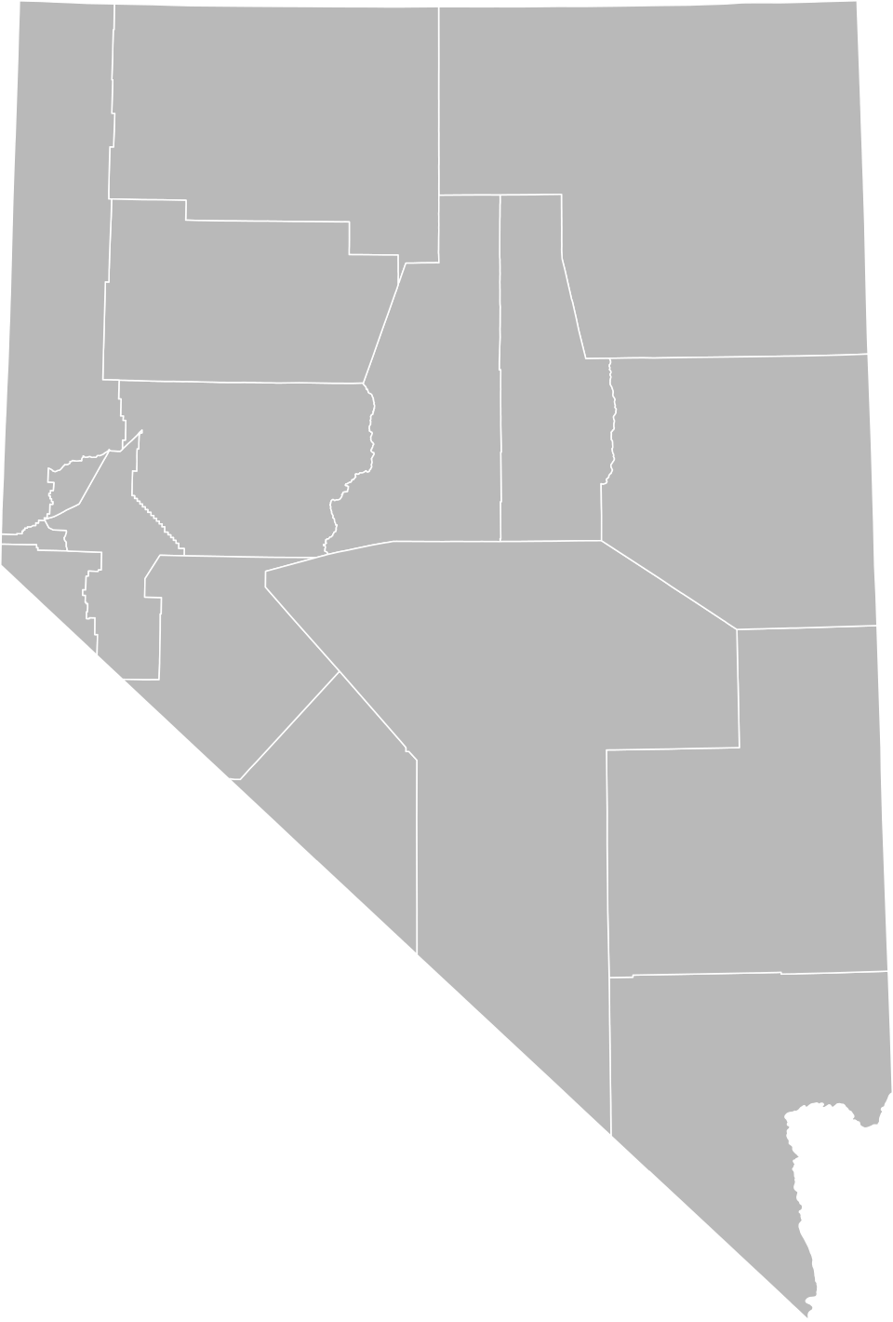
Maps & “tracks” (divide the county for coverage)
2026 Point-in-Time (PIT) Count • County Lead Training
What is a “track”?
A track is a defined zone (town/area + nearby routes) assigned to a Local Team Lead
Tracks prevent gaps and reduce duplication
Each track has: a map, a meeting point, assigned teams, and a completion check
Tracks should match real travel time and rural access constraints
Example visual only
(Statewide counties map)
Rural Nevada Continuum of Care (RNCoC)
Notes:
This is the heart of rural planning. Tracks can be towns, corridors, or “service hubs + surrounding rural roads.” The goal is simple: every place we intend to cover has an owner and a plan. [Sources] - https://commons.wikimedia.org/wiki/File:Blank_Map_of_Nevada.svg

Slide 13
Track planning: a simple 5-step process
2026 Point-in-Time (PIT) Count • County Lead Training
1
List towns/communities and service hubs
Start with where people already access services (shelters, food, clinics, libraries).
2
Gather local intel
Outreach teams, law enforcement, tribal partners, parks/public lands, community contacts.
3
Draw track boundaries
Use routes that make sense: travel time, daylight/night constraints, terrain, weather.
4
Assign ownership
Match each track to a Local Lead + number of volunteer teams needed.
5
Plan check-in/check-out
Set meeting points and require completion confirmation to avoid missed zones.
Rural Nevada Continuum of Care (RNCoC)
Notes:
This slide is the “how-to.” Emphasize that track planning is iterative: draft → review with partners → revise. Encourage County Leads to document assumptions (e.g., “this corridor is only safe in daylight” or “this public land access requires 4WD”).

Slide 14
County track template (fillable slide)
2026 Point-in-Time (PIT) Count • County Lead Training
Use this slide as a worksheet during planning. Duplicate it for each track if helpful.
Track plan (fill in)
County: ____________________________
Track name/ID: ______________________
Towns/areas included: _______________
Meeting point / staging location: ____
Local Team Lead (name + phone): _____
# volunteer teams assigned: _________
Known priority locations: ____________
Safety notes / access constraints: ____
INSERT TRACK MAP
(or screenshot from mapping tool)
Rural Nevada Continuum of Care (RNCoC)
Notes:
Encourage County Leads to keep track plans simple and readable. This slide is designed to duplicate: one slide per track can become your county’s final “route book.”

Slide 15
Preventing duplication & confirming coverage
2026 Point-in-Time (PIT) Count • County Lead Training
County Lead + Local Lead checklist
Every volunteer team has a named track + boundaries (map) before deployment
Launch check-in: “Team X started Track B at ___ time”
If teams encounter the same person/location: follow the de-duplication protocol in training
Completion check-out: “Track B complete; no additional sites found / sites found at ___”
Document gaps and reasons (weather, access, safety) so the story is clear
Pro tip: A simple “track completion log” (even a shared spreadsheet) prevents chaos.
Rural Nevada Continuum of Care (RNCoC)
Notes:
Explain that duplication can happen when hotspots attract multiple teams or when people move between locations. The best prevention is clear assignments plus check-ins. If something is missed, document why—good documentation protects the integrity of the count.

Slide 16
Safety & respectful engagement (non-negotiables)
2026 Point-in-Time (PIT) Count • County Lead Training
Safety basics
Respectful engagement
Always work in pairs/teams; never alone in remote areas
Do not enter tents, vehicles, or enclosed structures
Maintain situational awareness; trust your gut and leave if unsure
Use reflective gear/flashlights and plan for weather
Know the escalation path (Local Lead → County Lead → emergency services)
Introduce yourself clearly; explain this is voluntary
Use trauma-informed language: calm, non-judgmental, patient
If someone declines: thank them and move on—no pressure
Avoid collecting unnecessary personal details; follow survey prompts
Offer resource info if your local protocol includes it
Rural Nevada Continuum of Care (RNCoC)
Notes:
Reinforce that safety and dignity come first. County Leads should ensure Local Leads repeat these expectations during the pre-count huddle. If a volunteer team feels unsafe, they should stop and contact their Local Lead immediately.

Slide 17
The Count App (how it fits into the workflow)
2026 Point-in-Time (PIT) Count • County Lead Training
Why we use the app (benefits)
Standardizes survey questions and reduces missing fields
Speeds up data submission and post-count review
Supports consistent documentation of where coverage occurred
Makes it easier to train new volunteers (guided workflow)
County Lead expectation: confirm every Local Lead/team has access BEFORE count day.
Rural Nevada Continuum of Care (RNCoC)
Notes:
Keep this section practical. Our goal is to remove tech friction: ensure login, permissions, and practice are done ahead of time. If your county has limited cell coverage, discuss how the app handles low/no connectivity (insert local guidance here).

Slide 18

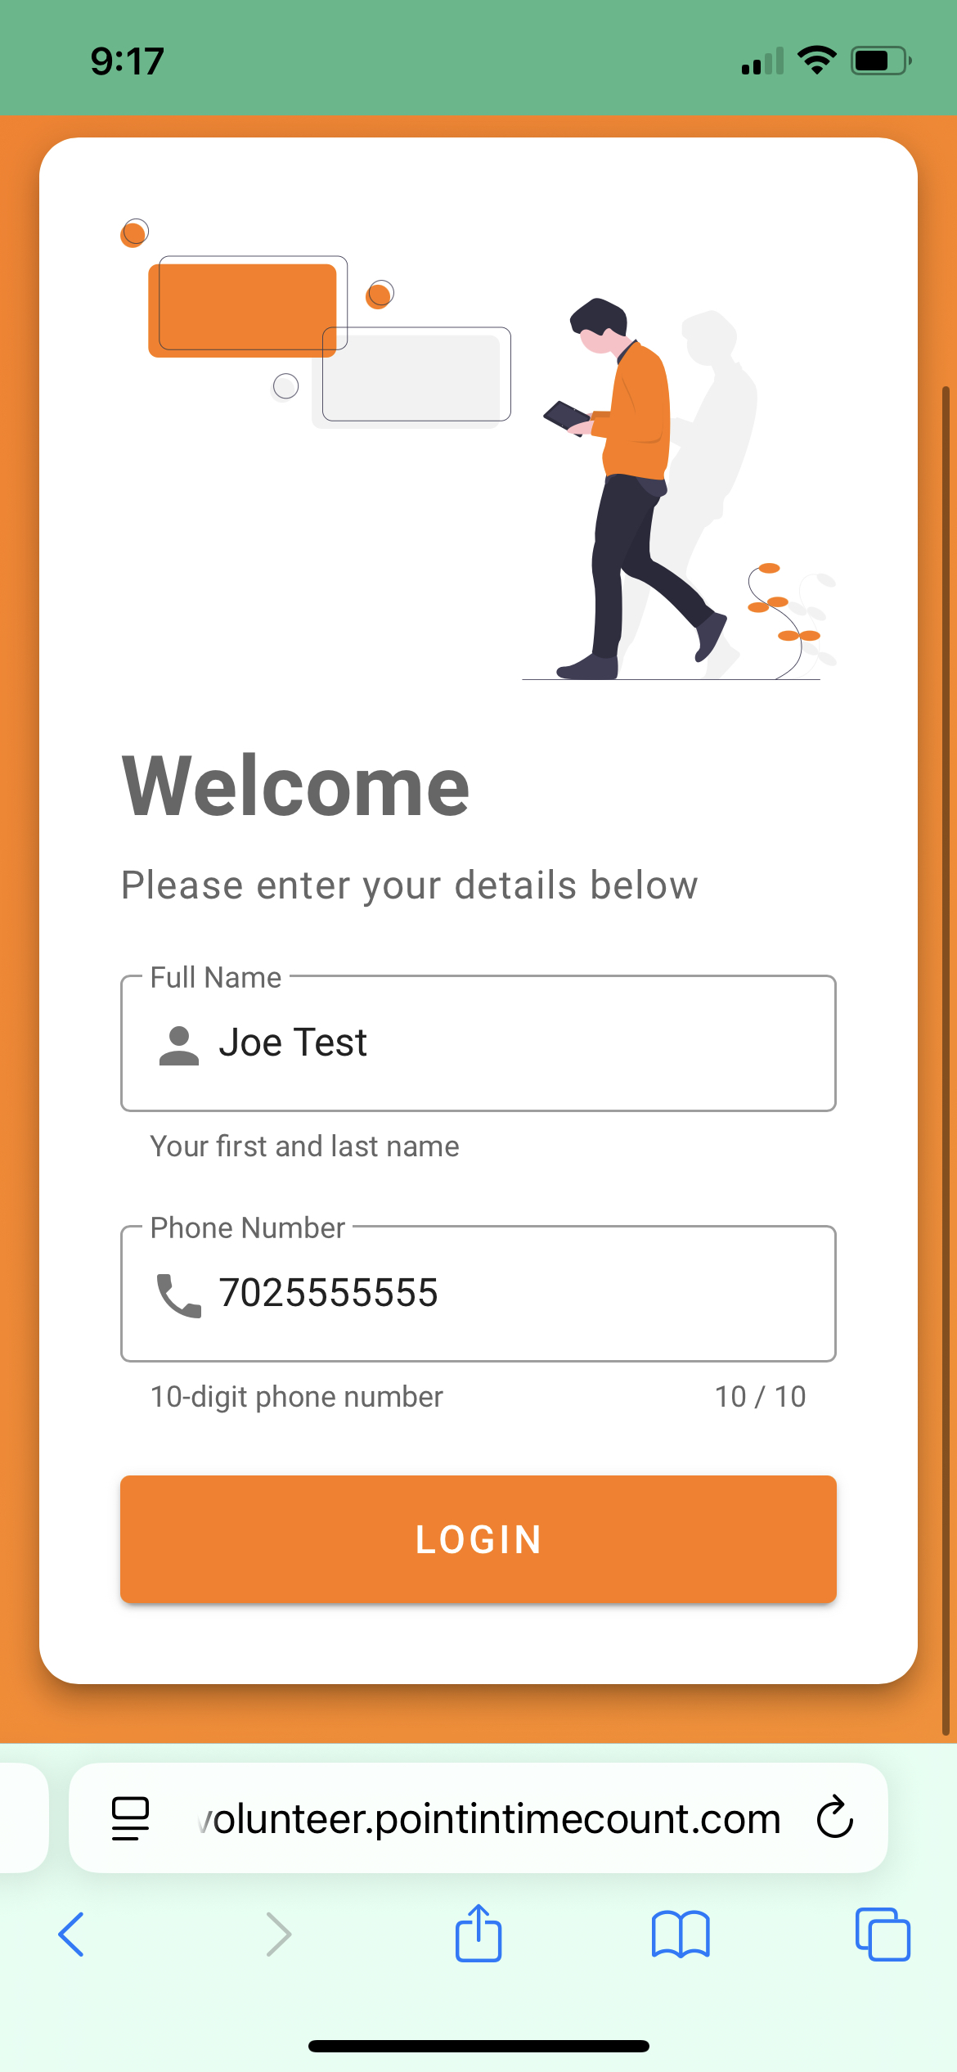


Accessing the Count App
2026 Point-in-Time (PIT) Count • County Lead Training
Step-by-step (replace placeholders)
1) Go to website: www.pitcounter.com
2) Enter: Survey Code (Enter code exactly as provided)
App Testing- VHX83J
PIT Survey will be provided prior to Count
3) Enter name and phone number (this is used for survey tracking purposes only and will not be provided for 3rd party and sales purposes.)
4) The map will automatically track your location; volunteers will be able to see the outline of their region
5) Complete a test survey
6) Troubleshooting contact (RNCoC/app support):
Email: rncoc@wingedwolf.org
Phone:
Rural Nevada Continuum of Care (RNCoC)
Notes:
This slide is intentionally a plug-in. Insert the app download link, login steps, and screenshots that match your actual app. Ask County Leads to test access themselves and then confirm every Local Lead can log in.

Slide 19
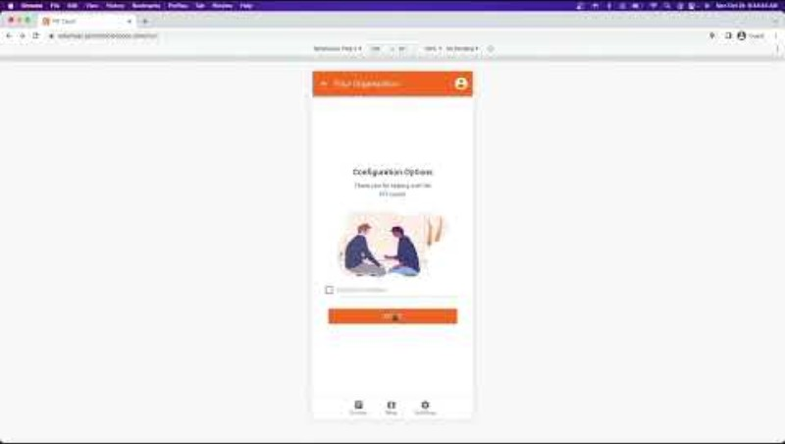
App walkthrough video (from the app creator)
2026 Point-in-Time (PIT) Count • County Lead Training
How to use this video
Assign as pre-work for Local Leads and volunteer teams
Pause at key steps during training (login, start survey, submit)
Collect questions and route to RNCoC/app support
Rural Nevada Continuum of Care (RNCoC)
Notes:
Recommendation: ask all Local Leads to watch in advance so count day isn’t the first time they open the app. If you embed a hyperlink, include it in the presenter notes or on-screen as a short URL.

Slide 20
App practice & troubleshooting checklist
2026 Point-in-Time (PIT) Count • County Lead Training
Practice expectations
Quick fixes (common)
Every team completes at least 1 test survey before count day
Confirm the device is charged and has needed permissions enabled
Confirm how the app behaves with low/no cell coverage (insert local guidance)
Confirm who to contact for technical issues during the count
Can’t log in → verify email/credentials + reset password
App crashes/freezes → restart app/device; check updates
Location services off → enable permissions (if required)
No connectivity → use offline workflow (if available) and sync later
Low battery → car charger/power bank plan
Rural Nevada Continuum of Care (RNCoC)
Notes:
Stress that practice reduces errors. If your region has spotty connectivity, decide on a standard approach and communicate it consistently (offline mode, paper backup, sync locations, etc.).

Slide 21
Data quality (what “complete” looks like)
2026 Point-in-Time (PIT) Count • County Lead Training
Common issues to prevent
County Lead review (after count)
Missing required fields (household type, sleeping location, demographics)
Duplicate entries for the same person/household
Misclassification of sheltered vs. unsheltered
Incomplete notes when a location is inaccessible or unsafe
Confirm every track has a completion check-out
Scan for missing fields or obvious duplicates
Flag issues quickly for RNCoC support
Submit on time with any required documentation (maps/logs)
Rural Nevada Continuum of Care (RNCoC)
Notes:
Reinforce: our goal is usable data. County Leads don’t need to “audit everything,” but you should do a quick sanity check: tracks complete, obvious errors, and missing documentation handled. [Sources] - https://files.hudexchange.info/resources/documents/PIT-Count-Methodology-Guide.pdf

Slide 22
Count-day operations (County Lead checklist)
2026 Point-in-Time (PIT) Count • County Lead Training
Day-of Logistics with Volunteers
Count teams can take a staggered approach to counting
Counting in more populous areas (well lit part of cities and counties) can start at 5:00 AM with Volunteers arriving to meeting locations at 4:00 AM
Leads should ensure that all volunteers and team leads have applications downloaded on cellphones and devices for use
Provide a review of the training video
If it’s not written down, it didn’t happen: keep a simple log of decisions and coverage.
Rural Nevada Continuum of Care (RNCoC)
Notes:
This slide is a practical script for count day. Encourage County Leads to print it or keep it open. The “log” is important for transparency and learning.

Slide 23
Count-day operations (County Lead checklist)
2026 Point-in-Time (PIT) Count • County Lead Training
Day-of checklist (print this)
Confirm Local Leads and volunteer teams are present (or activate backups)
Track assignments, and meeting points
Verify app access (or paper backup plan) before deployment
Launch check-in: who is covering which track and when
Monitor progress; re-route teams if gaps appear
Handle safety issues and escalations promptly
Completion check-out for every track; collect notes on barriers
Notify Coordinators once all tracks have been completed
If it’s not written down, it didn’t happen: keep a simple log of decisions and coverage.
Rural Nevada Continuum of Care (RNCoC)
Notes:
This slide is a practical script for count day. Encourage County Leads to print it or keep it open. The “log” is important for transparency and learning.

Slide 24
After the count: submission, debrief, improvement
2026 Point-in-Time (PIT) Count • County Lead Training
Submit
Debrief questions (capture while fresh)
Track completion confirmations
App submissions synced/confirmed
Notes on inaccessible areas, safety issues, and weather impacts
Partner feedback (what worked, what didn’t)
Were any tracks understaffed or too large?
Which locations were “new” or unexpected this year?
What caused the biggest delays or confusion?
What would you change about recruitment/training?
What should RNCoC know for next year’s planning?
Rural Nevada Continuum of Care (RNCoC)
Notes:
The debrief is where we improve. Even if results aren’t perfect, a well-documented process plus clear lessons learned strengthens future counts. Encourage County Leads to submit debrief notes promptly.

Slide 25
Next steps & contacts
2026 Point-in-Time (PIT) Count • County Lead Training
Next steps (this week)
RNCoC PIT Lead:
Name: __________________
Phone: ________________
Email: ________________
App Support:
Name/Email: ___________
Emergency:
Call 911
Confirm your county’s Local Team Leads (and backups)
Draft your first track map and share for review
Launch volunteer recruitment using RNCoC templates
Verify app access for you and at least one Local Lead
Schedule a short check-in with RNCoC PIT Lead as needed
Thank you for leading this work.
Rural Nevada Continuum of Care (RNCoC)
Notes:
Close with clarity. If County Leads do only three things: (1) recruit Local Leads, (2) build tracks, (3) ensure app access + practice — the count will be dramatically smoother. Invite questions and remind them where support lives.

